Slide 1
Age-depth modelling - theory

Slide 2
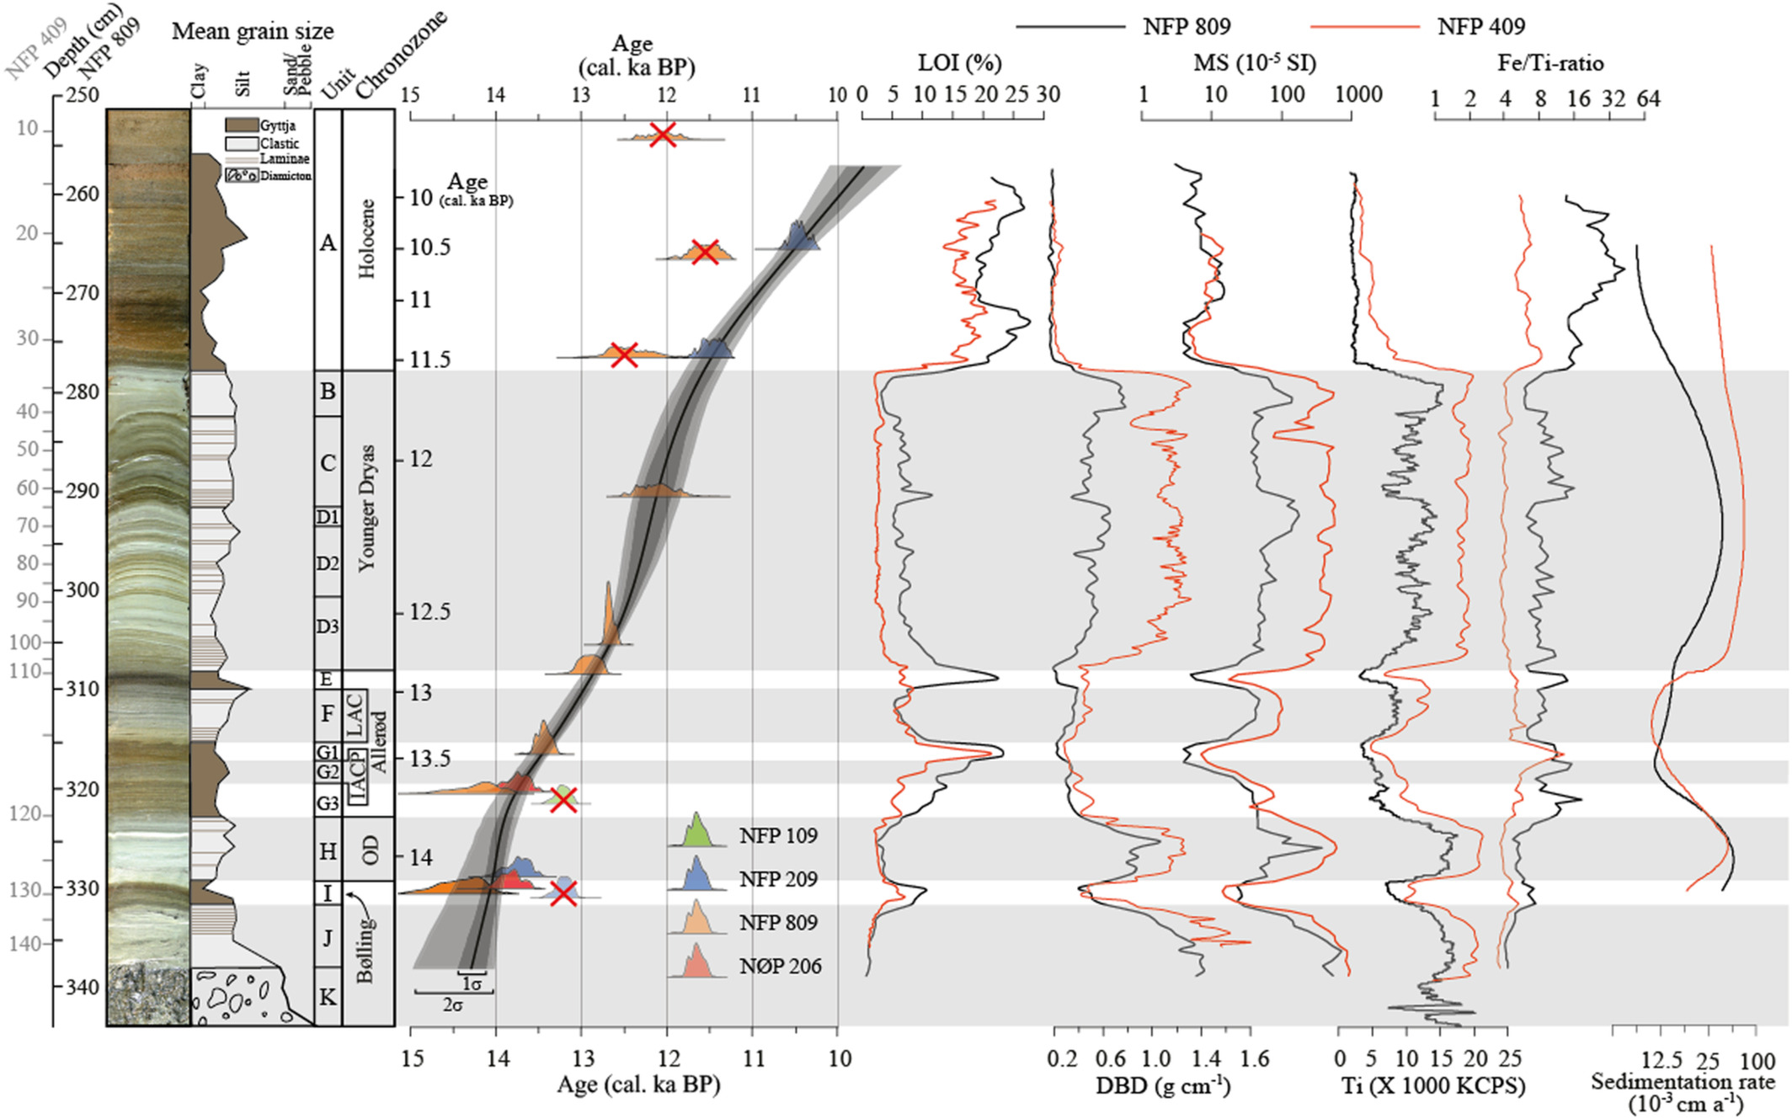
Jansen et al. (2023) Boreas doi:10.1111/bor.12609

Slide 3
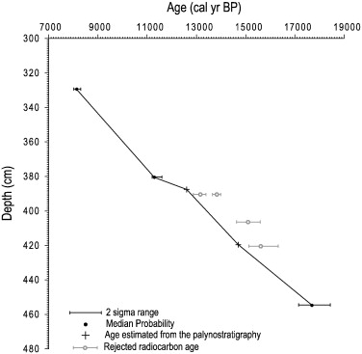
Googling for age-depth model
Millet et al. 2012. Chironomid-based reconstruction of Lateglacial summer temperatures from the Ech palaeolake record (French western Pyrenees). PalPalPal 315: 86-99

Slide 4
Googling for age-depth model
Millet et al. 2012. Chironomid-based reconstruction of Lateglacial summer temperatures from the Ech palaeolake record (French western Pyrenees). PalPalPal 315: 86-99

Slide 5
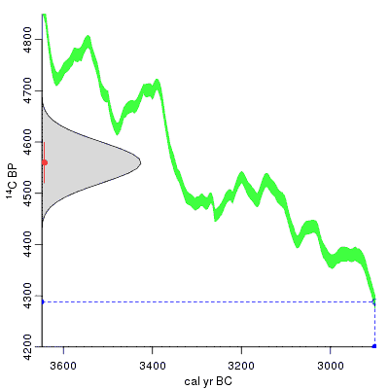
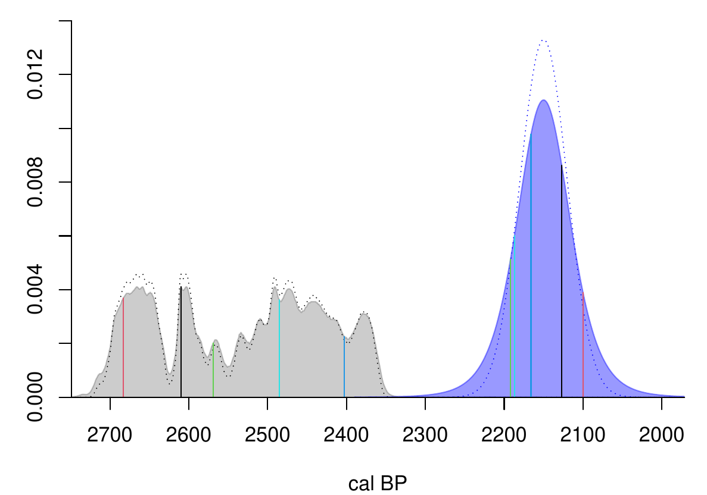
Googling for age-depth model
Which point estimates?
Millet et al. 2012. Chironomid-based reconstruction of Lateglacial summer temperatures from the Ech palaeolake record (French western Pyrenees). PalPalPal 315: 86-99

Slide 6
Googling for age-depth model
Which point estimates?
Reject dates?
Millet et al. 2012. Chironomid-based reconstruction of Lateglacial summer temperatures from the Ech palaeolake record (French western Pyrenees). PalPalPal 315: 86-99

Slide 7
Googling for age-depth model
Which point estimates?
Reject dates?
How connect points?
Millet et al. 2012. Chironomid-based reconstruction of Lateglacial summer temperatures from the Ech palaeolake record (French western Pyrenees). PalPalPal 315: 86-99

Slide 8
Googling for age-depth model
Which point estimates?
Reject dates?
How connect points?
Uncertainty?
Millet et al. 2012. Chironomid-based reconstruction of Lateglacial summer temperatures from the Ech palaeolake record (French western Pyrenees). PalPalPal 315: 86-99

Slide 9
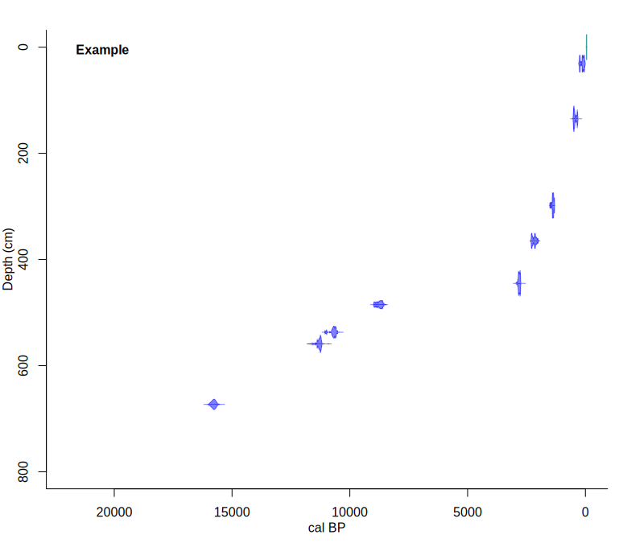
Which age-depth model?
800 cm core
9 ¹⁴C dates
surface = recent
Notes:
<number>

Slide 10
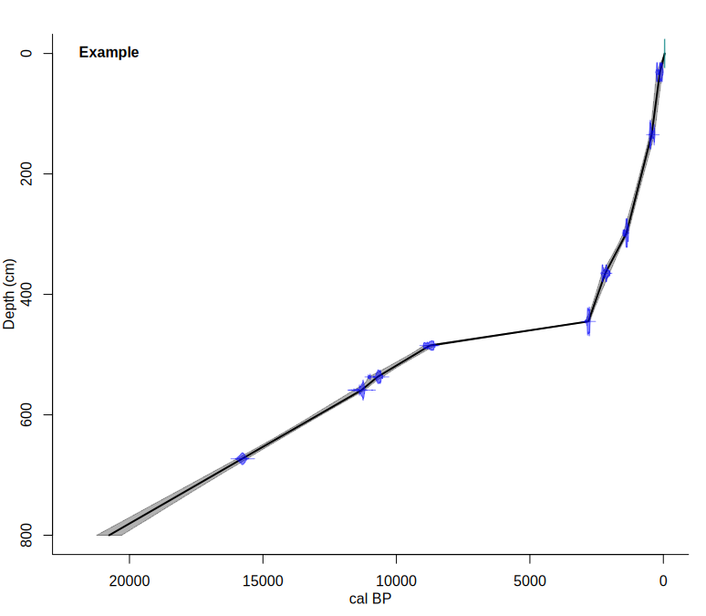
Which age-depth model?
800 cm core
9 ¹⁴C dates
surface = recent
“Classical” age-model
Linear interpolation
require(clam)
clam()
Notes:
<number>

Slide 11
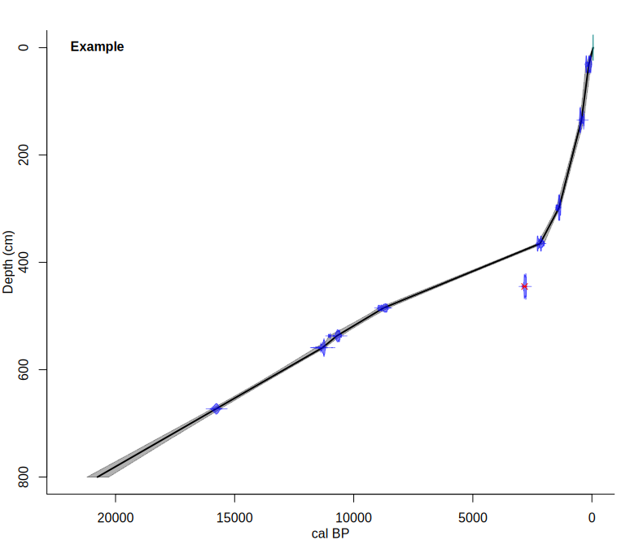
Which age-depth model?
800 cm core
9 ¹⁴C dates
surface = recent
Linear interpolation
date 6 = outlier
clam(outliers=6)
Notes:
<number>

Slide 12
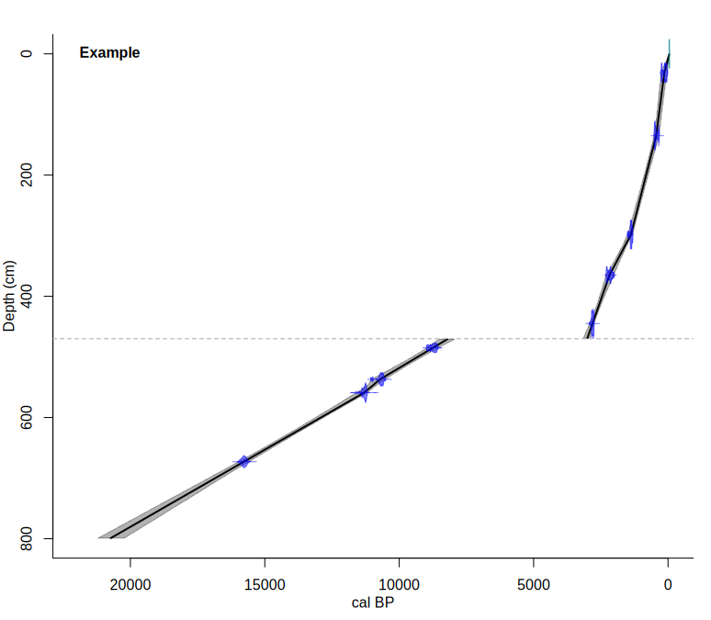
Which age-depth model?
800 cm core
9 ¹⁴C dates
surface = recent
Linear interpolation
470 cm = hiatus
clam(hiatus=470)
Notes:
<number>

Slide 13
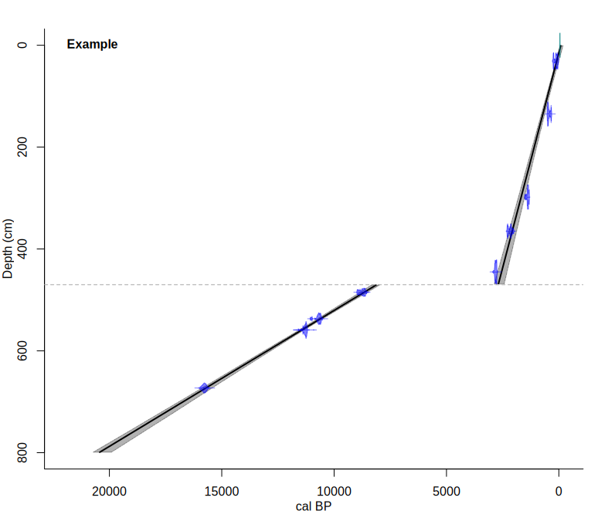
Which age-depth model?
800 cm core
9 ¹⁴C dates
surface = recent
Linear regression
470 cm = hiatus
clam(,2, outliers=6)
Notes:
<number>

Slide 14
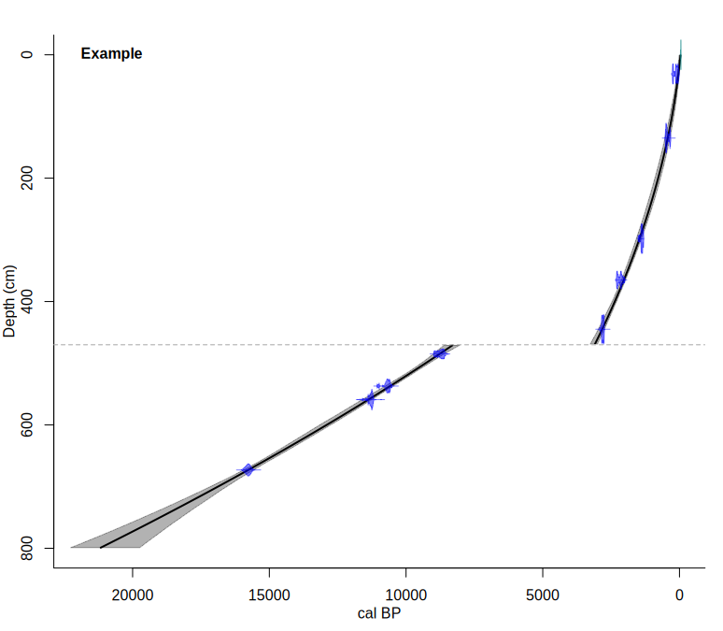
Which age-depth model?
800 cm core
9 ¹⁴C dates
surface = recent
Polynomial regression
470 cm = hiatus
second degree
clam(,2,2,hiatus=470)
Notes:
<number>

Slide 15
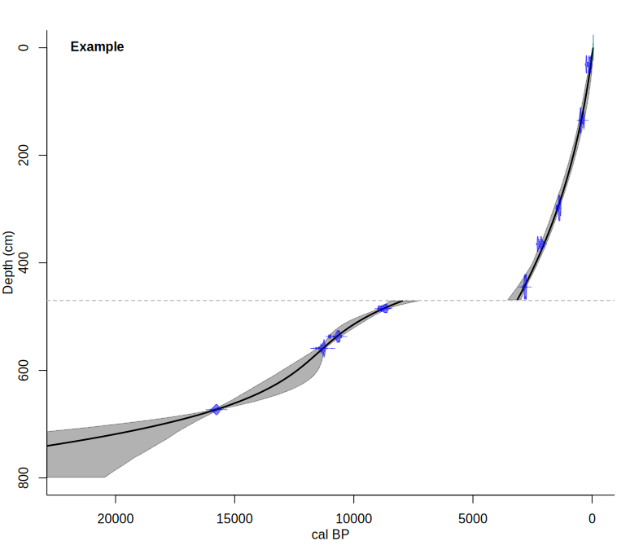
Which age-depth model?
800 cm core
9 ¹⁴C dates
surface = recent
Polynomial regression
470 cm = hiatus
third degree
clam(,2,3,hiatus=470)
Notes:
<number>

Slide 16
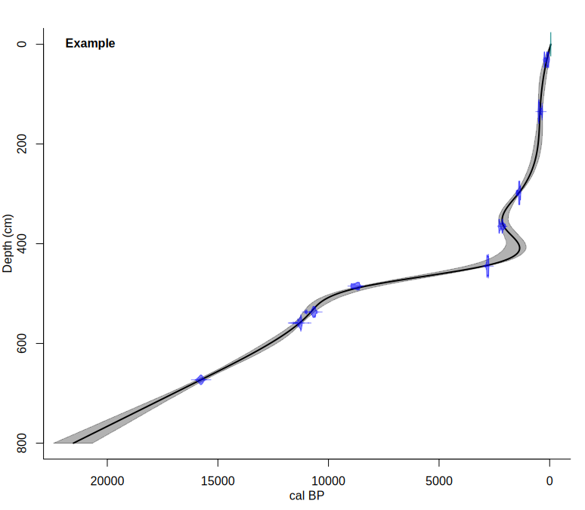
Which age-depth model?
800 cm core
9 ¹⁴C dates
surface = recent
Smooth spline
clam(,4)
Notes:
<number>

Slide 17
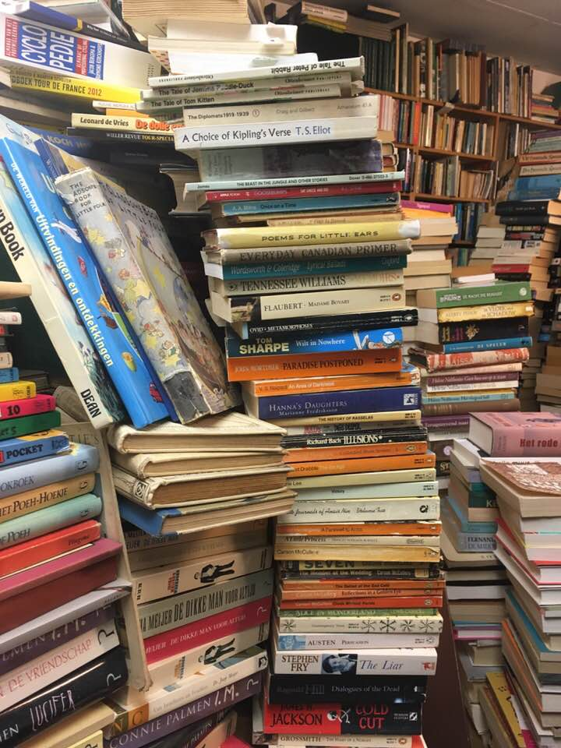

Slide 18
Which age-depth model?
800 cm core
9 ¹⁴C dates
surface = recent
Smooth spline
date 6 = outlier
clam(,4, outliers=6)
Notes:
<number>

Slide 19
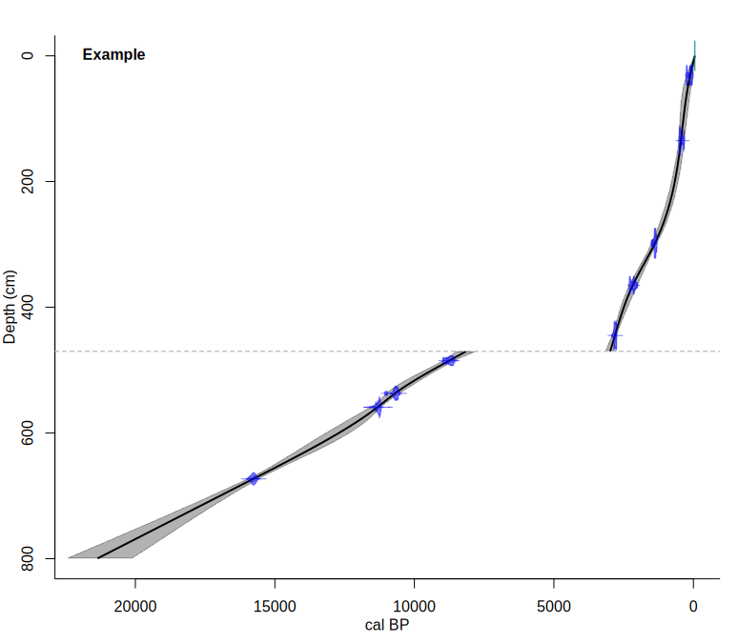
Which age-depth model?
800 cm core
9 ¹⁴C dates
surface = recent
Smooth spline
470 cm = hiatus
clam(,4, hiatus=470)
Notes:
<number>

Slide 20
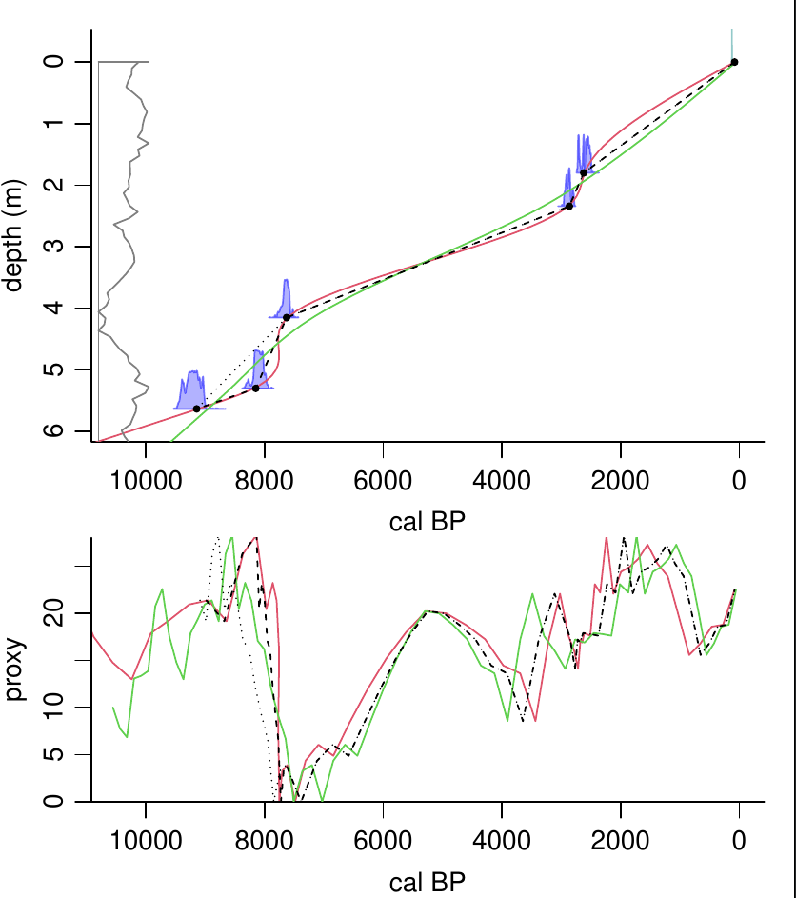

Slide 21
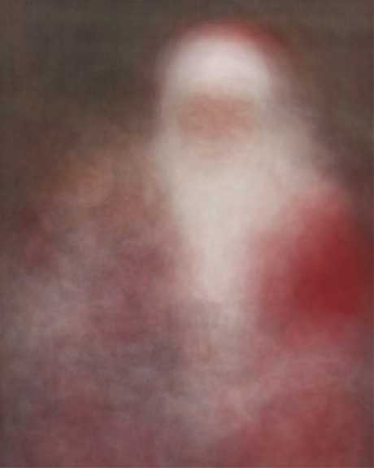
Jason Salavon 100 Special Moments
Notes:
<number>

Slide 22
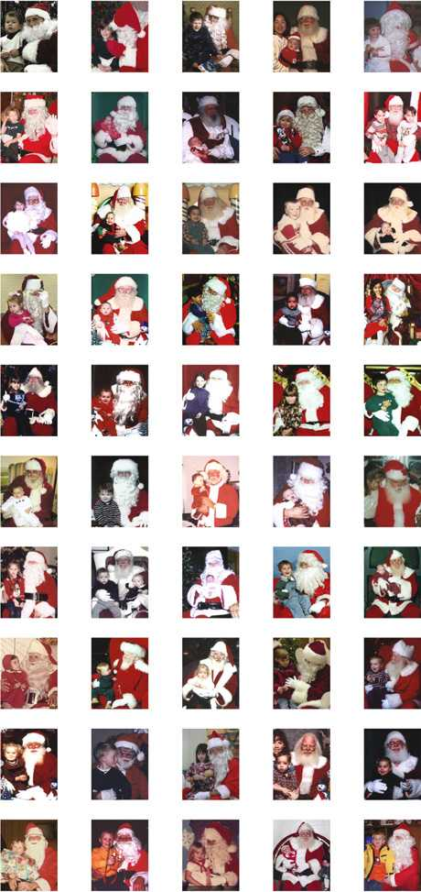
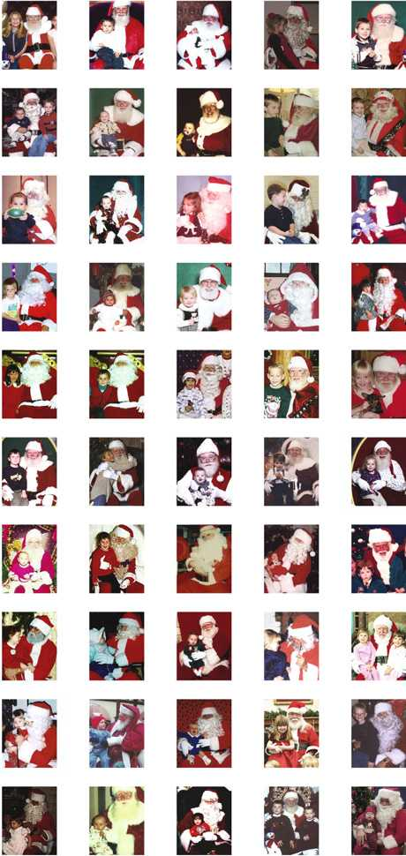
Notes:
<number>

Slide 23
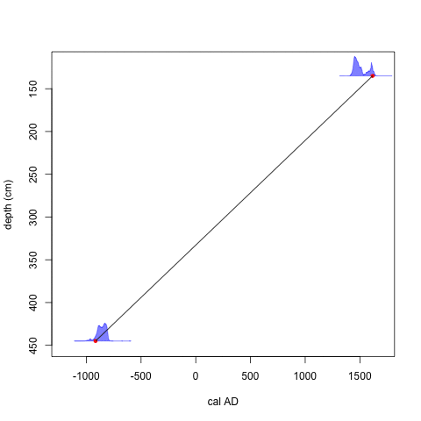

Slide 24
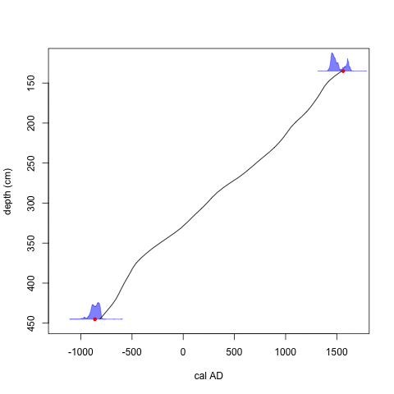

Slide 25
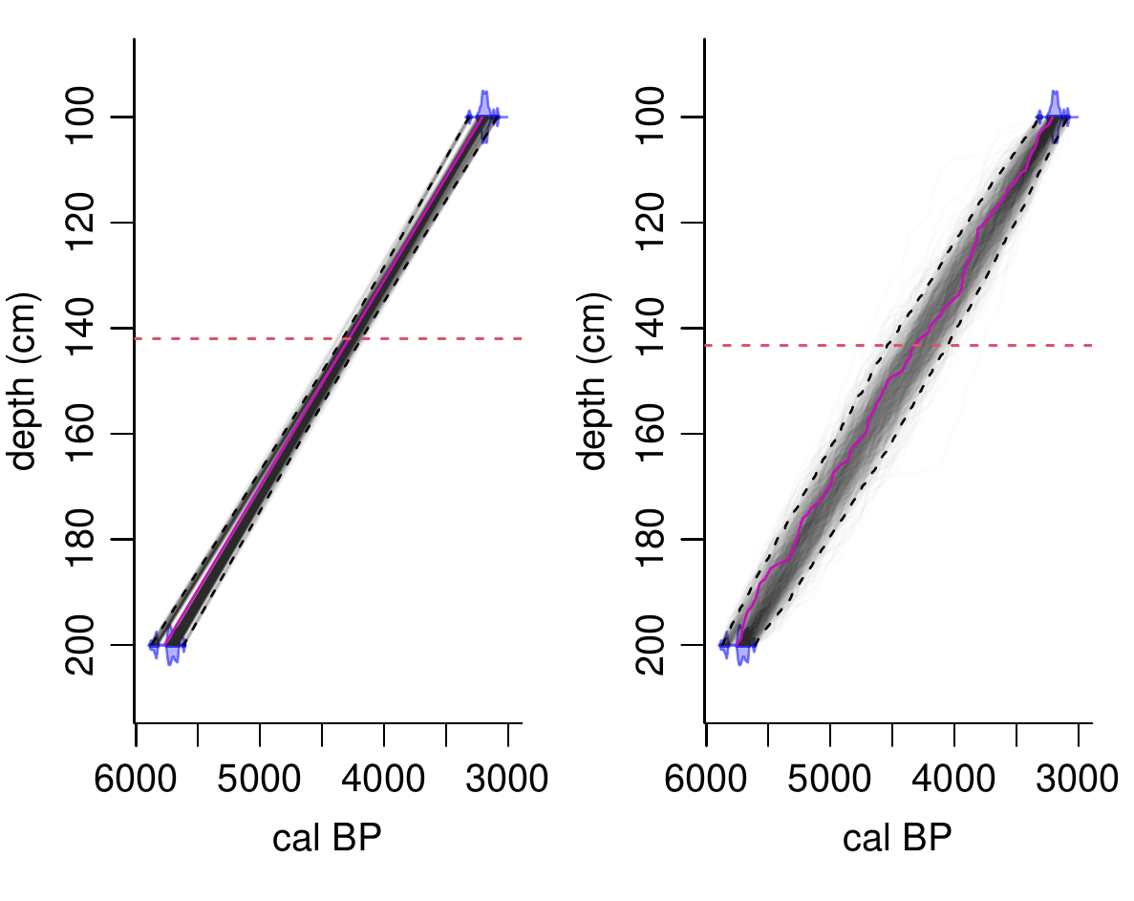

Slide 26
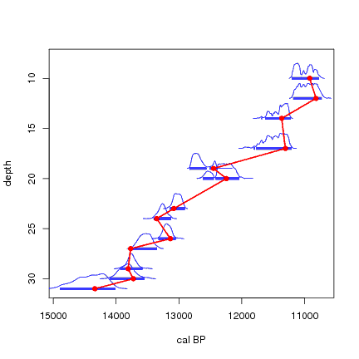
Stratigraphic order dates
Christen, 1994. Appl Stat 43:489-503
Only accept iterations with correct order
Reduces error ranges
Removes outliers
Hard to question
Notes:
<number>

Slide 27
install.packages(‘coffee’)
require(coffee)
strat()

Slide 28
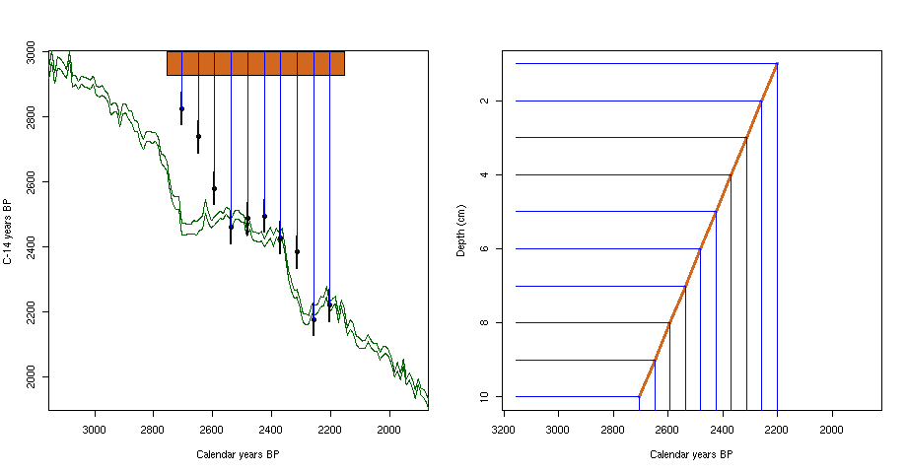
Wiggle-match dating
Assume linear accumulation‏
age = a*depth + b
Notes:
<number>

Slide 29
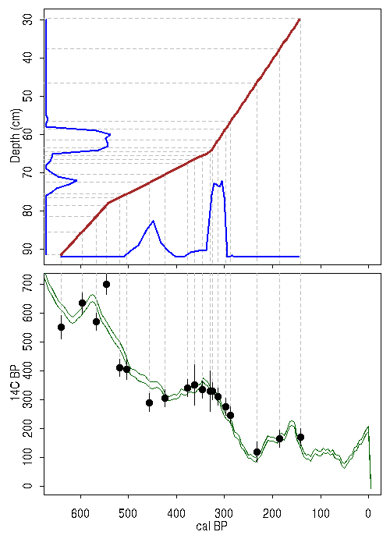
Wiggle-match dating
Notes:
<number>

Slide 30
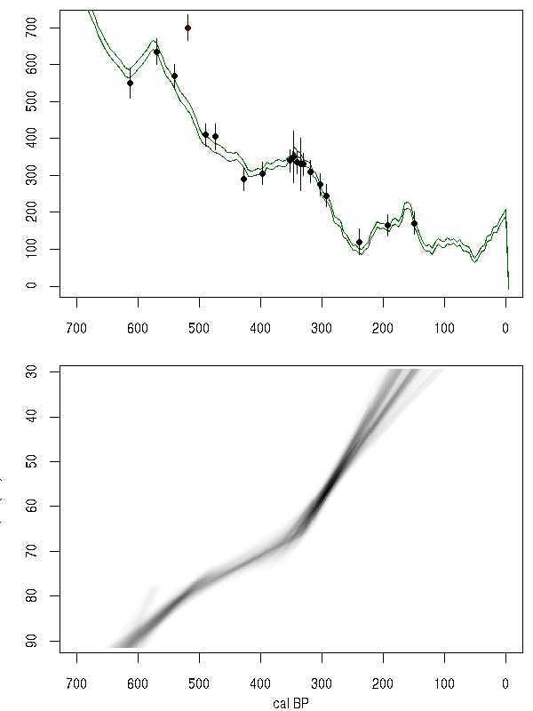
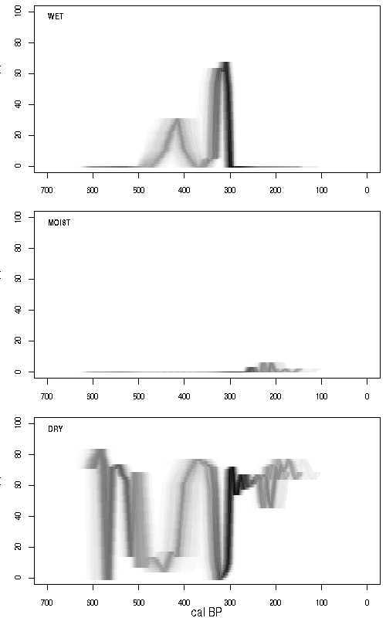
Notes:
<number>

Slide 31
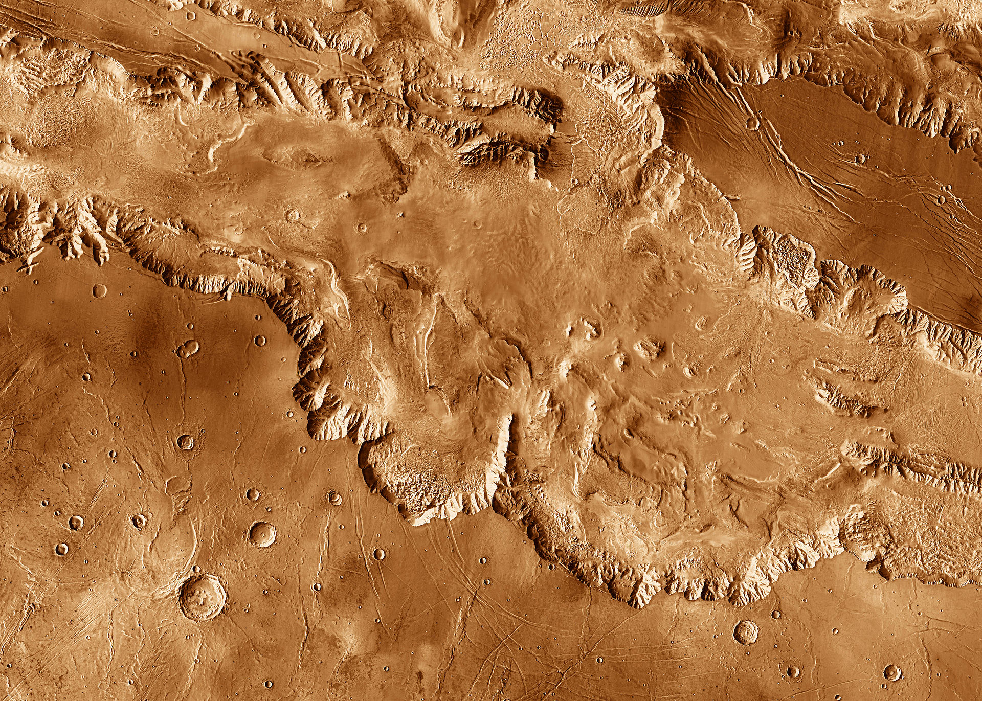
Melas basin, Mars
Williams & Weitz 2014 (Icarus)
~45 m of layered deposits
Earth sedrates 1-50 year/cm in E North America (Goring et al., 2012)
4,500 – 230,000 yr

Slide 32
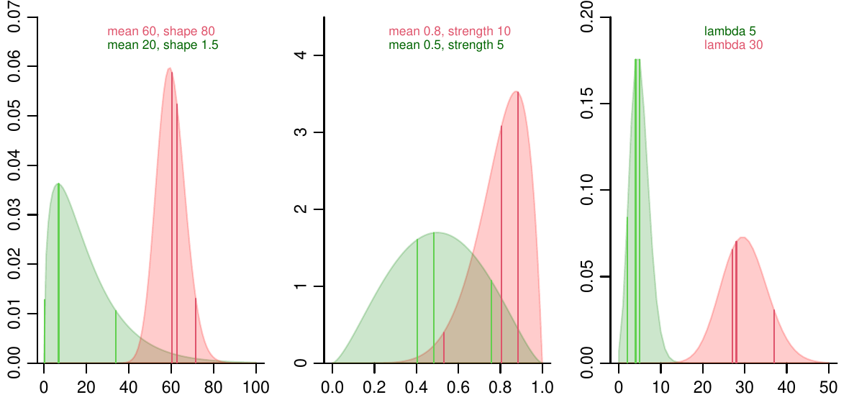

Slide 33
https://vimeo.com/602614709

Slide 34
Markov-Chain Monte Carlo (MCMC)
Example: age-depth model
Divide 200 cm core into 4 50cm-sections (section elbows not necessarily where dates are)
Linear accumulation rate within each section (gamma prior distr)
4 ¹⁴C dates
For each iteration, calculate product of p(priors) * p(dates)

Slide 35
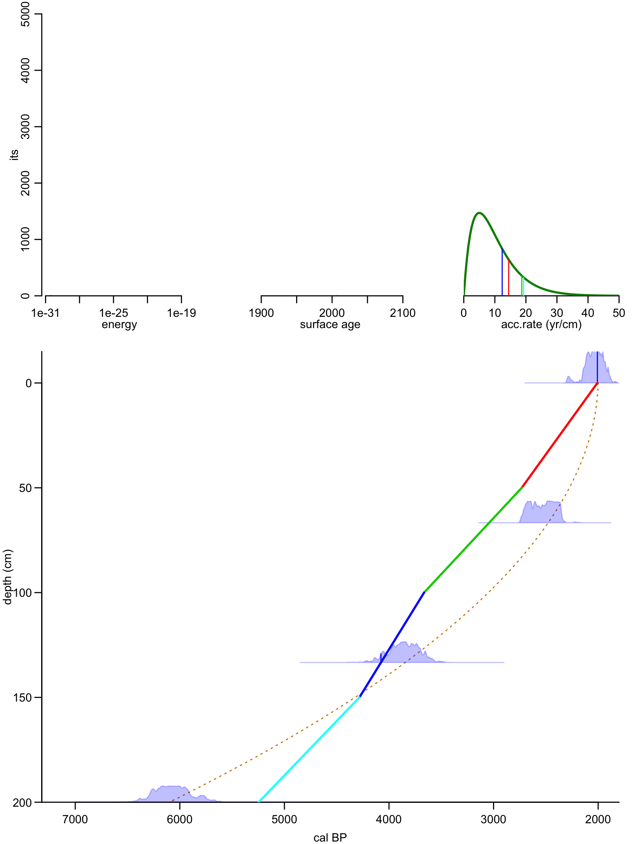
Markov-Chain Monte Carlo (MCMC)
Ballpark iteration: simulate accs. from gamma prior
4 likelihoods for accs (heights of prob. distr.)
Also simulate top date (uniform)
This defines the entire model
Now calculate fit of model w dates
4 likelihoods for dates

Slide 36
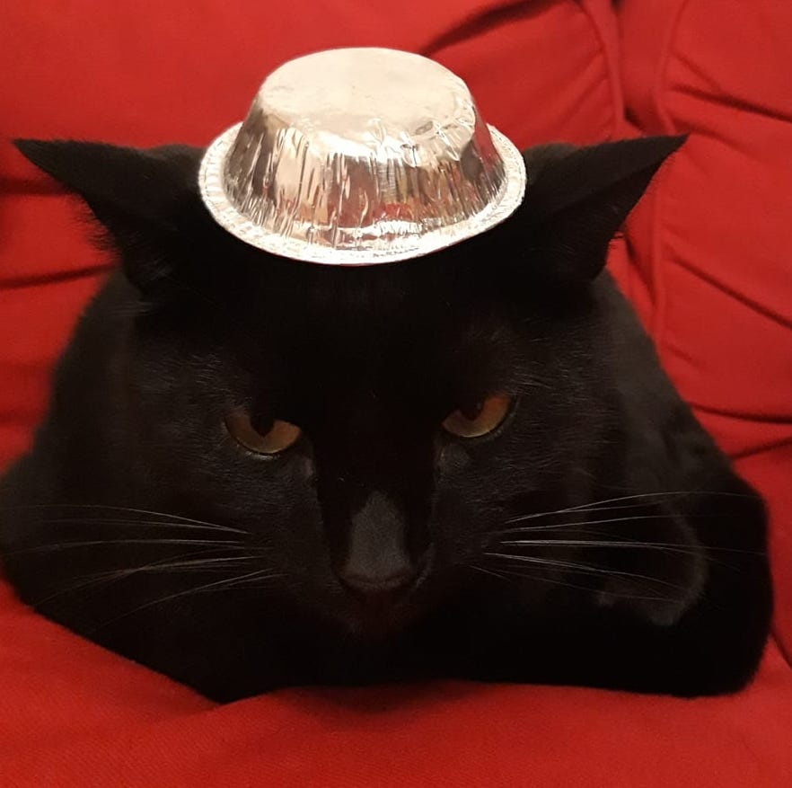
Markov-Chain Monte Carlo (MCMC)
Ballpark iteration: simulate accs. from gamma prior
4 likelihoods for accs (heights of prob. distr.)
Also simulate top date (uniform)
This defines the entire model
Now calculate fit of model w dates
4 likelihoods for dates
https://vimeo.com/548372489

Slide 37
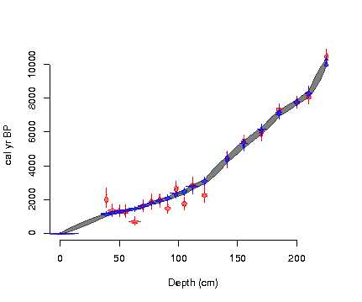
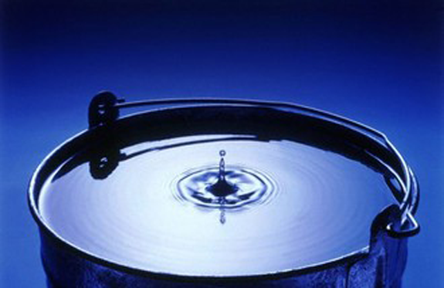
Bayesian age-depth model techniques
OxCal, Bchron, Bpeat, Bacon
Accumulation modelled as increments
k-value dictates degree of flexibility
k can be set fixed or adapting to data
Interpolation between dates or every cm
Notes:
<number>

Slide 38
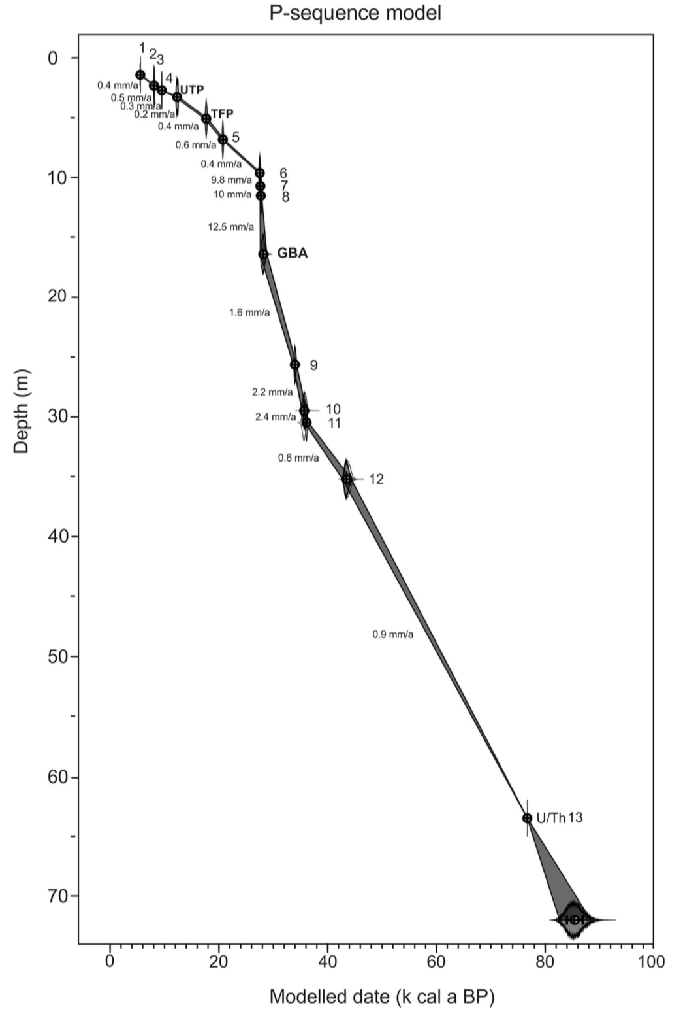
Torres-Rodriguez et al. 2018 JQS

Slide 39
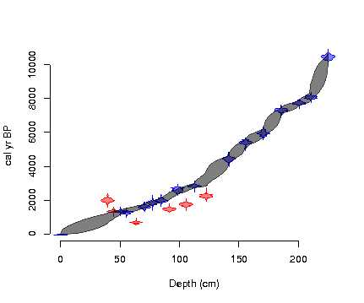
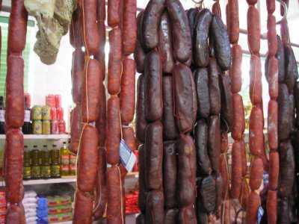
Bayesian age-depth model techniques
OxCal, Bchron, Bpeat, Bacon
Gamma jumps in depth and age
No adaptable settings
Notes:
<number>

Slide 40
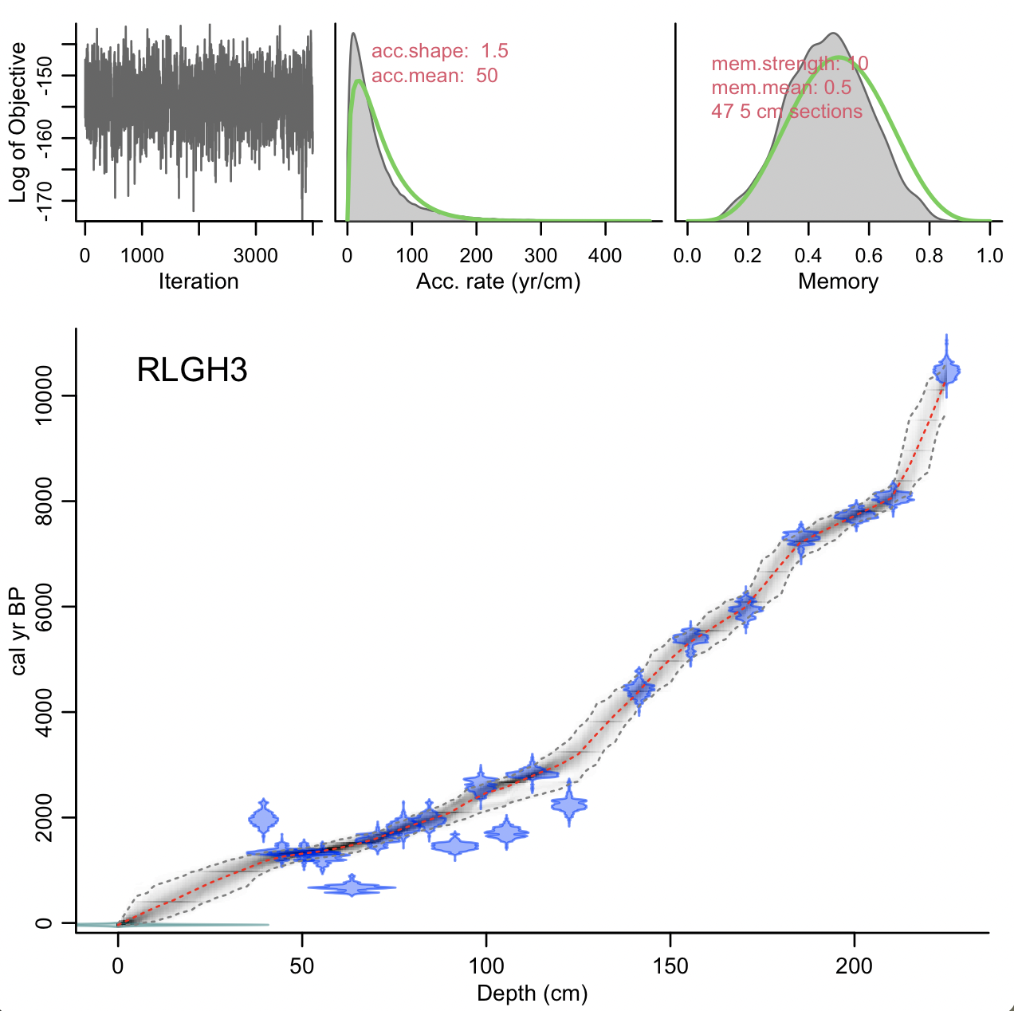
Bayesian age-depth model techniques
If you will begin with certainties, you shall end in doubts,
but if you will content to begin with doubts,
you shall end in certainties. After Francis Bacon (AD 1561 - 1626)
OxCal, Bchron, Bpeat, Bacon
Adaptable priors:
Accumulation rate
Accumulation rate variability
Hiatus length
Notes:
<number>

Slide 41
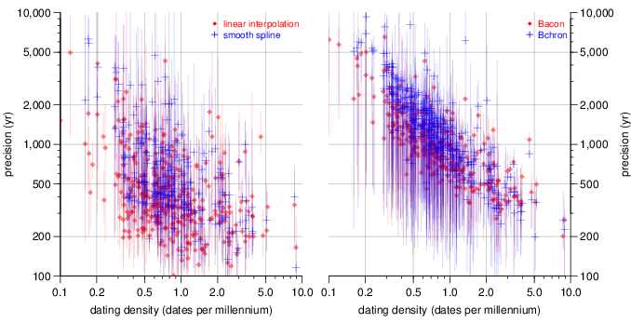
Meta-analysis of existing cores
Blaauw et al. 2018 QSR

Slide 42
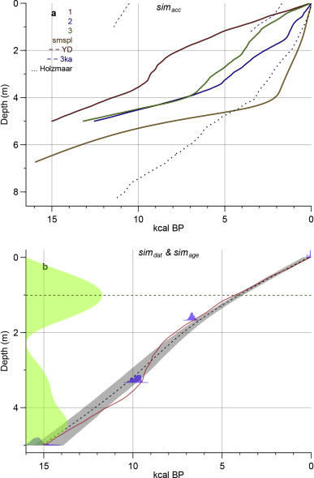
Blaauw et al. 2018 QSR

Slide 43
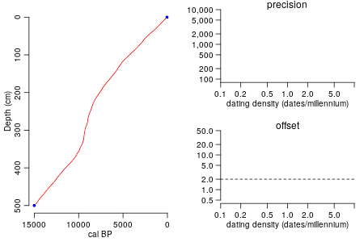
Linear interpolation
Blaauw et al. 2018 QSR

Slide 44
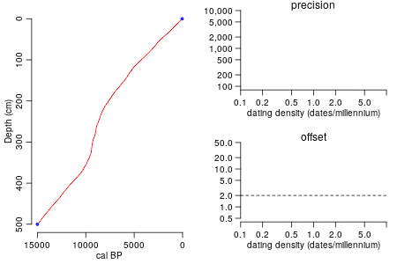
Bayesian: Bacon
Blaauw et al. 2018 QSR

Slide 45
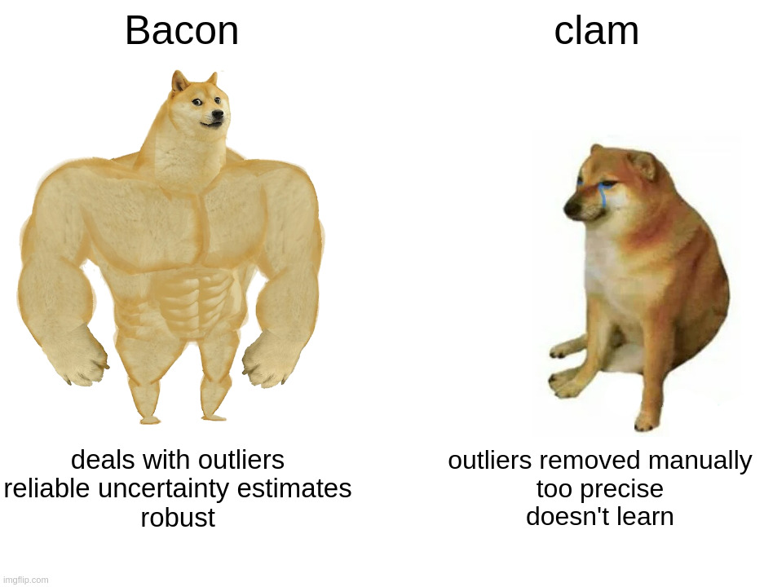
Classical vs Bayesian (Bacon/Bchron)
Classical models
Fast and “conveniently” precise even at low dating densities
But precision illusionary! Large offsets likely
More dates do not increase precision
Outliers can be disastrous
Popular but not well suited to their tasks
Bayesian: Bacon/Bchron
Slower, and larger uncertainties at low dating densities
High accuracy, realistic precision estimates
Each additional date will tell us more
Handle outliers well
Outperform classical models at all tested dating densities
Blaauw et al. 2018 QSR

Slide 46
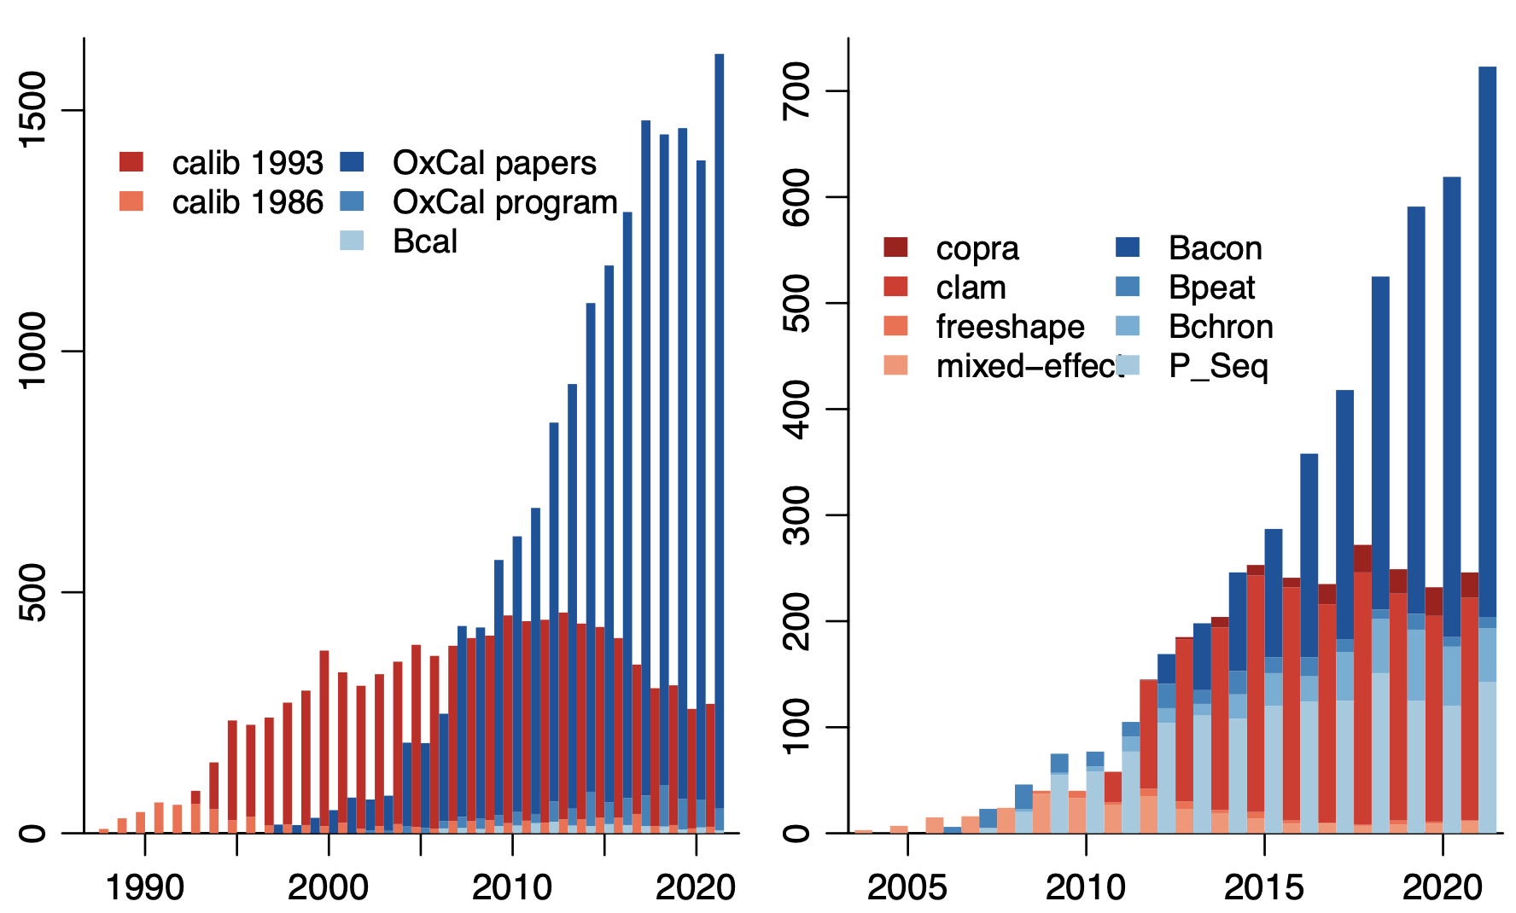
Scholar.google citations to calibration/age-modeling (left) and age-depth modeling (right) software

Slide 47
https://vimeo.com/548368871

Slide 48
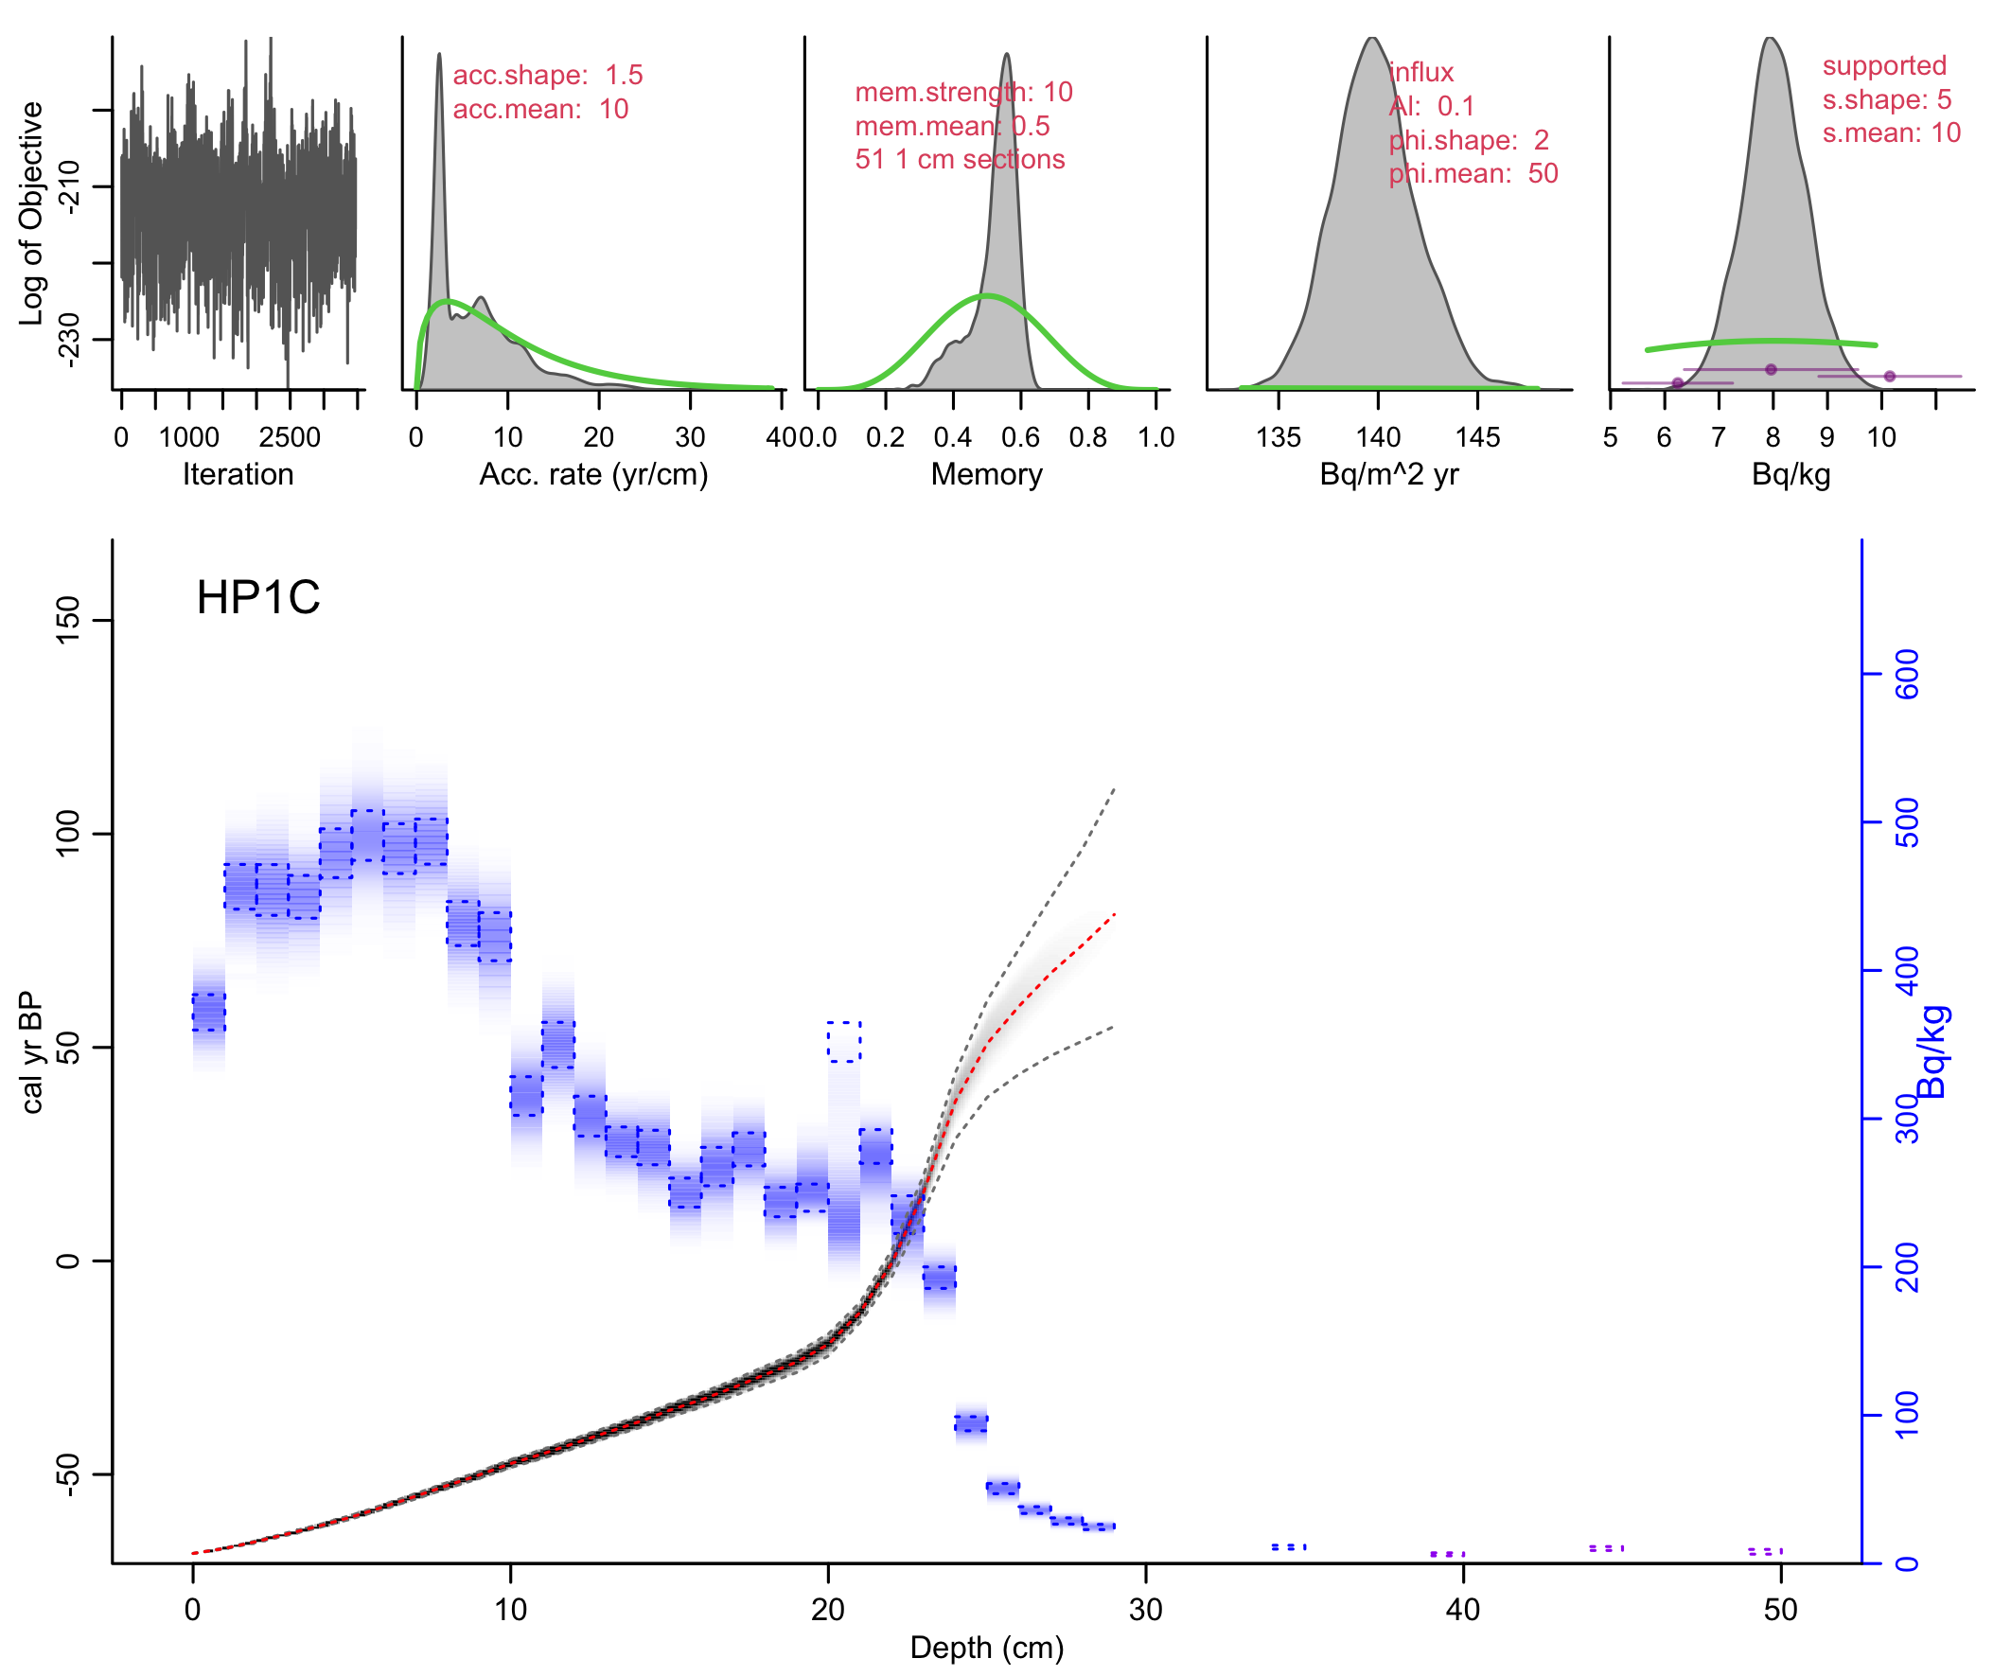
Only ²¹⁰Pb, supported ²¹⁰Pb estimated from tail ²¹⁰Pb measurements
Blue ²¹⁰Pb: measured in rectangles, modelled in “bluescale”
All parameters involved in producing age-model and modelled ²¹⁰Pb

Slide 49
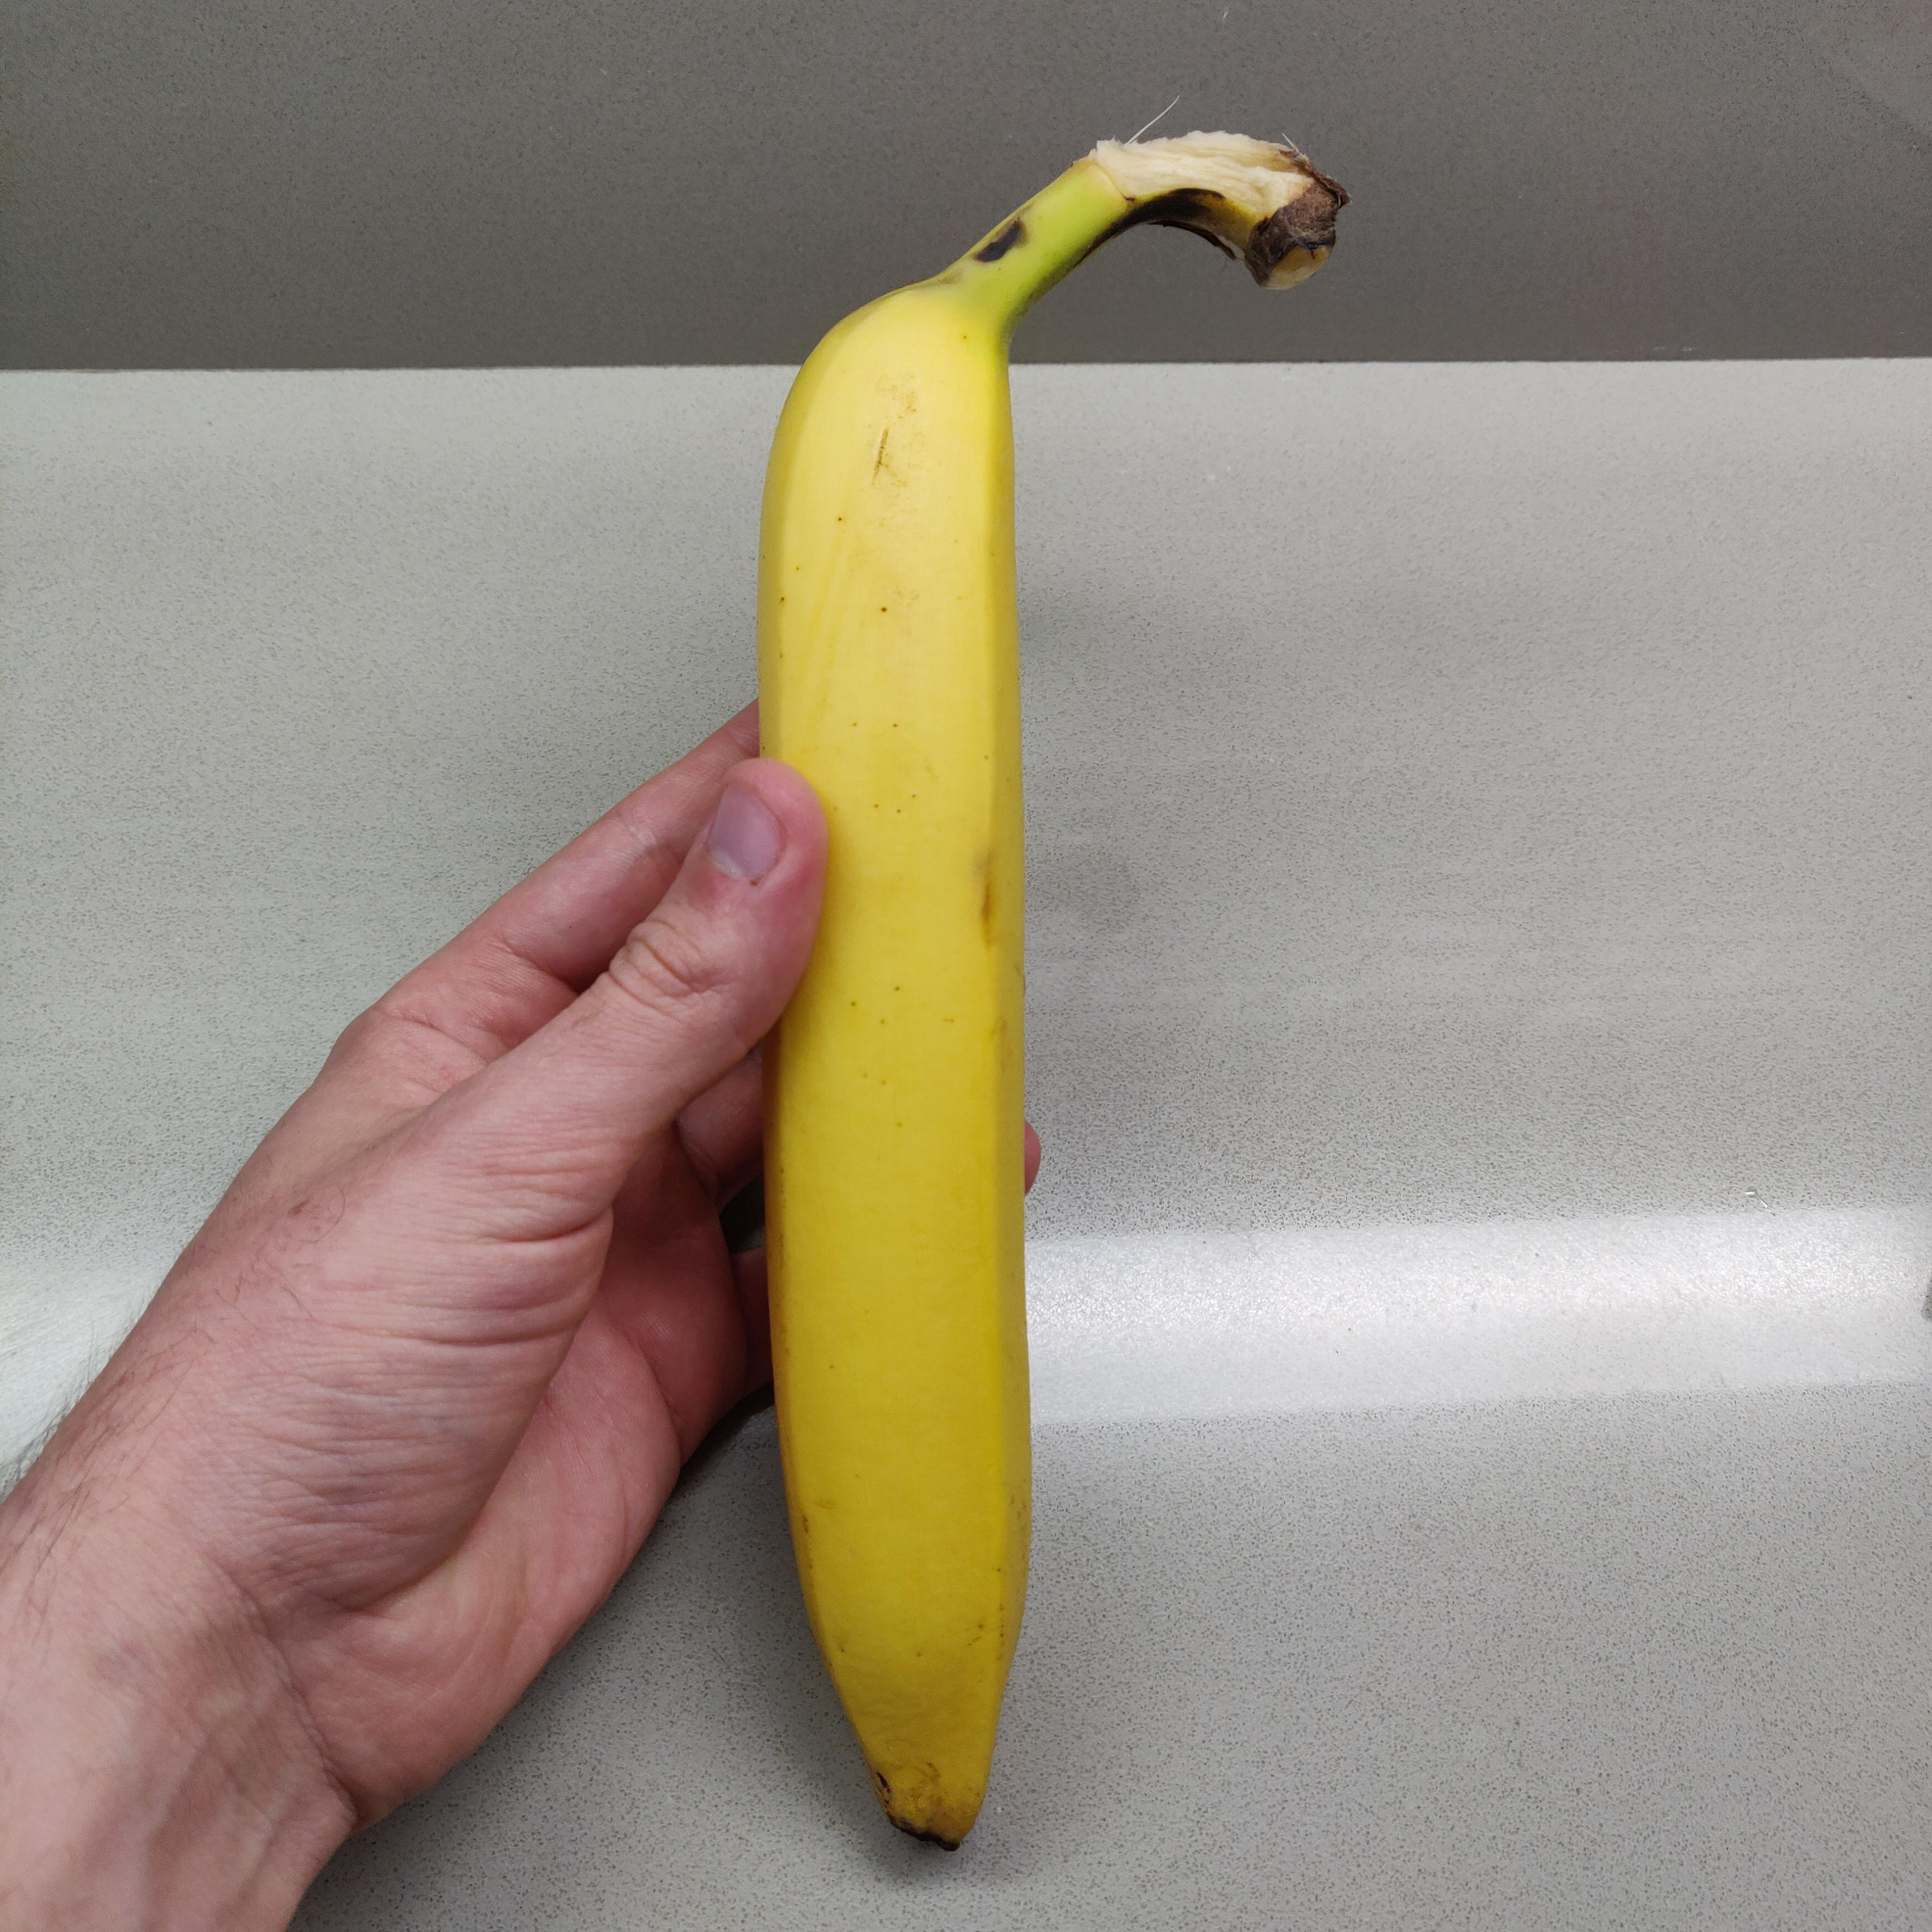
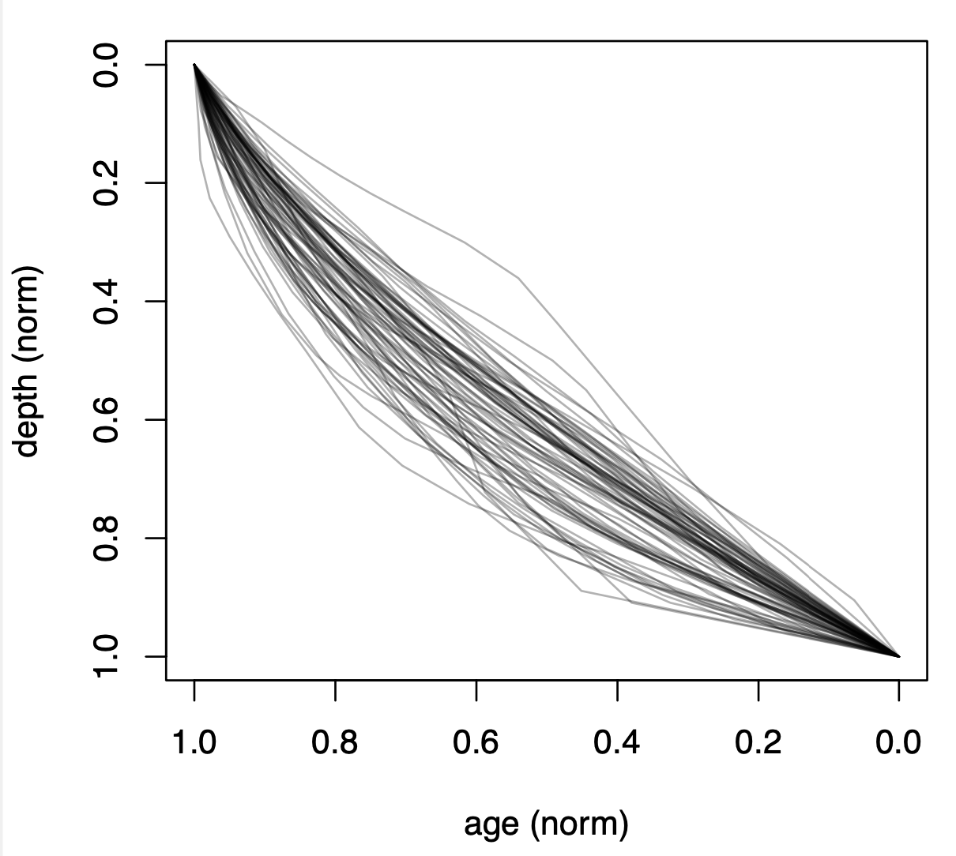
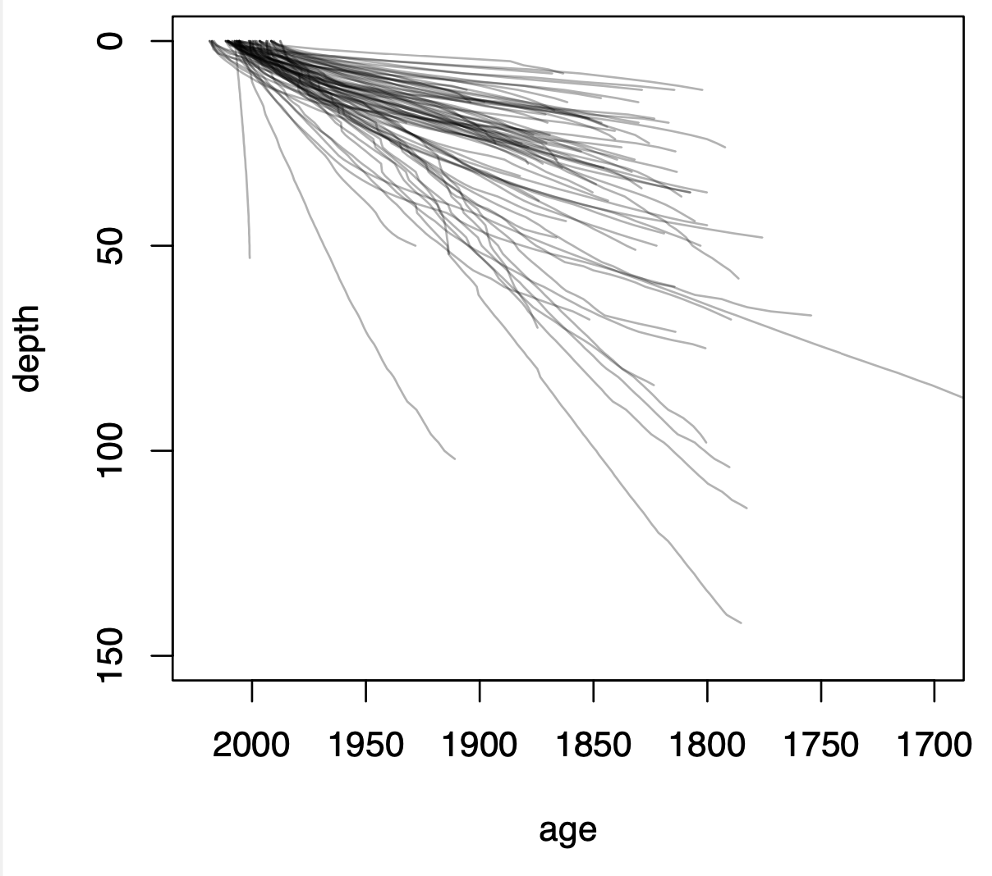
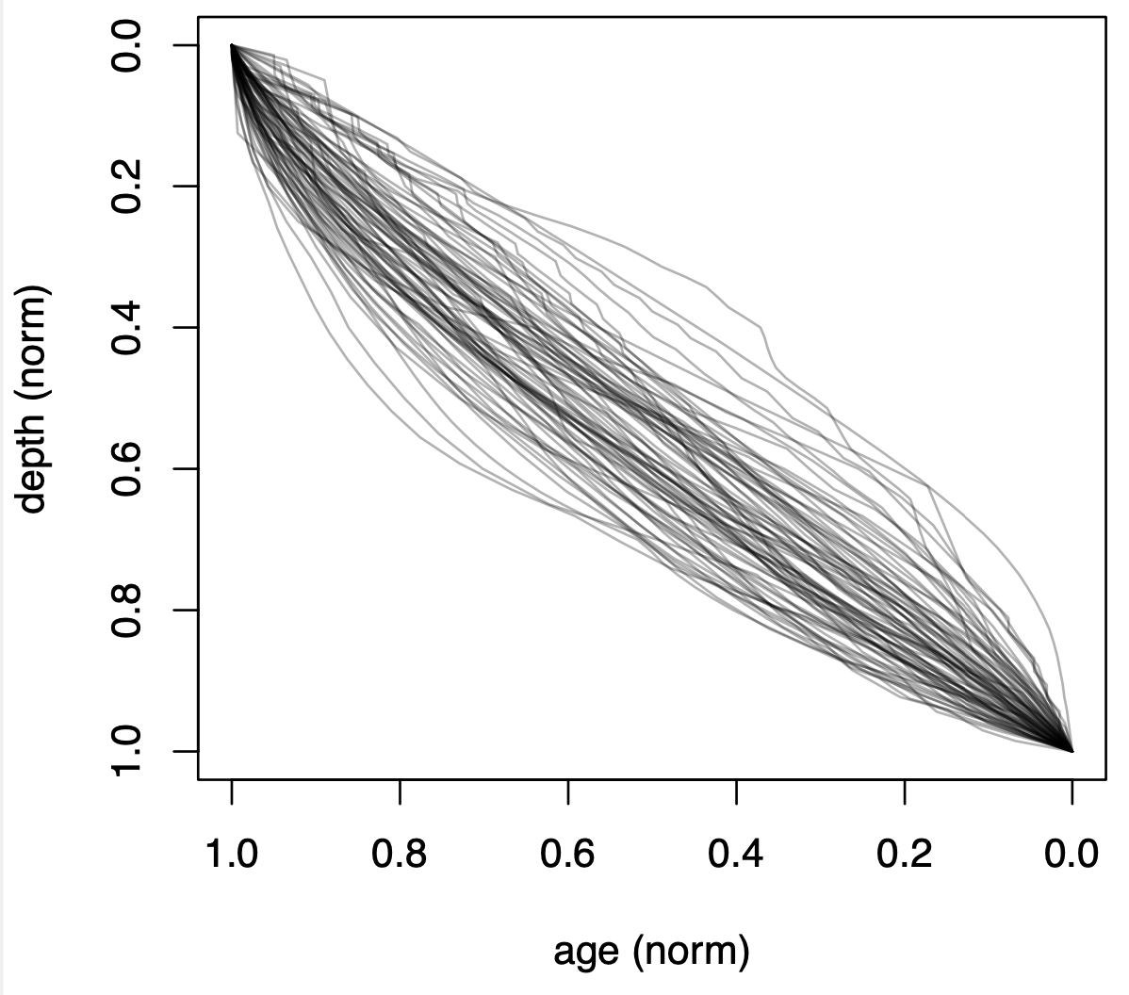
NERC SeedCorn project
plum
plum
crs

Slide 50
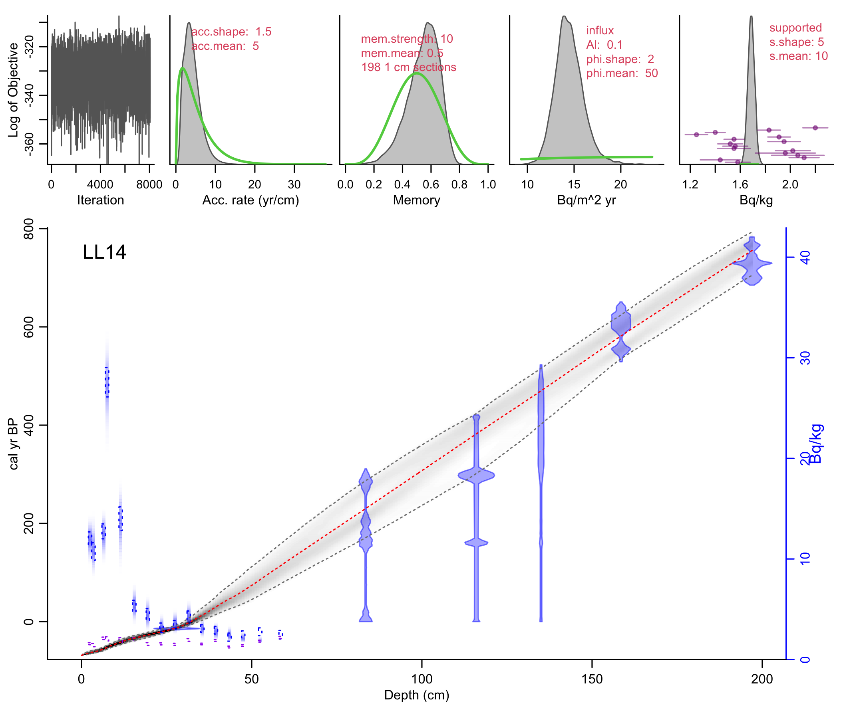
Easy to include other dates such as radiocarbon or historical dates
No inbuilt curvature
But explicit limits on accumulation rate and variability

Slide 51
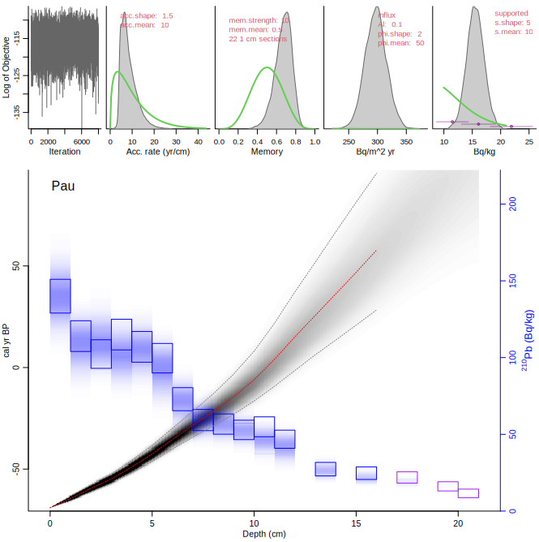

Slide 52
